Slide 1
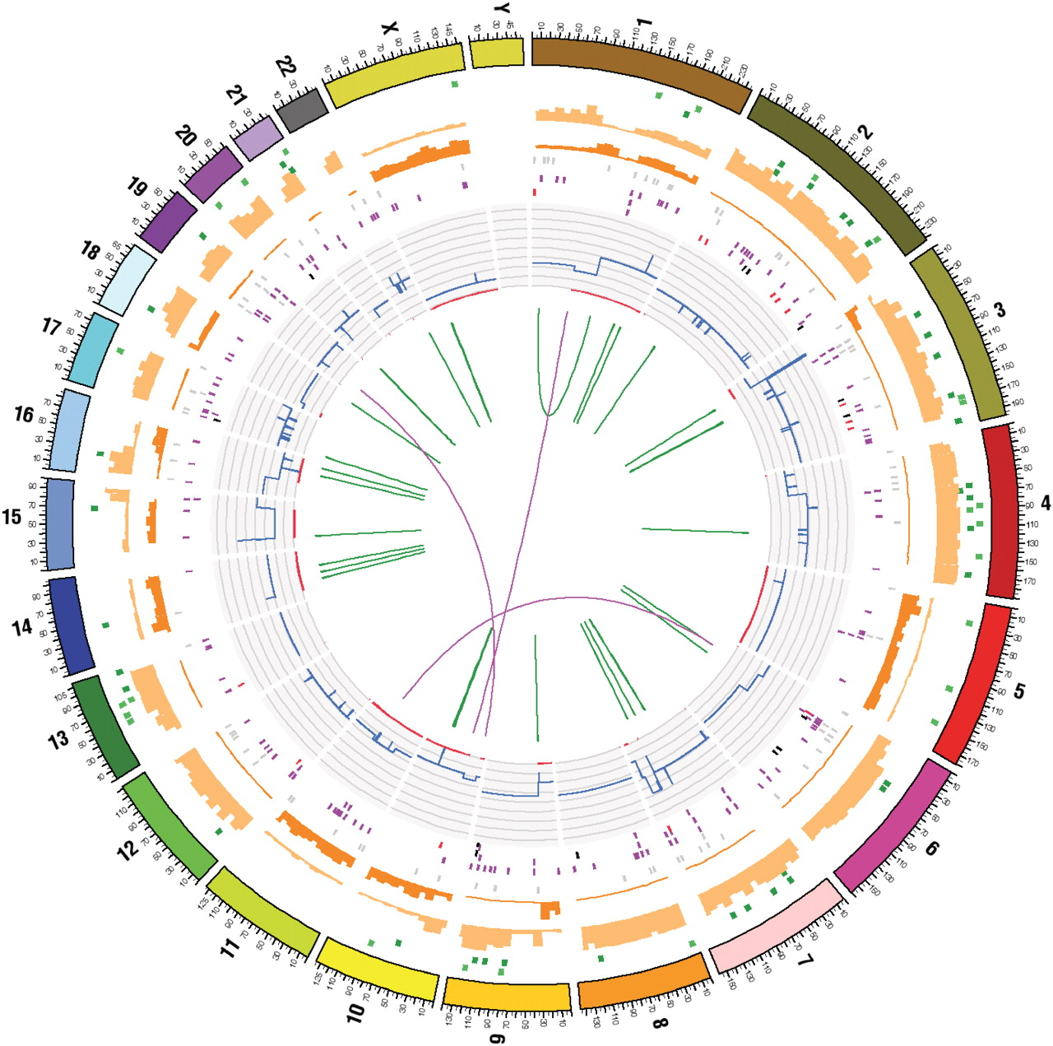

Circos diagram summarizing the full somatic mutation content of cell line NCI-H209.
Forbes S A et al. Nucl. Acids Res. 2011;39:D945-D950
© The Author(s) 2010. Published by Oxford University Press.
Notes:
Circos diagram summarizing the full somatic mutation content of cell line NCI-H209. Concentric rings summarize the data on different types of mutation. From the inside out, the core displays the structural rearrangements; intrachromosomal are in green, interchromosomal in purple. The next ring out shows the chromosomal copy number in histogram form, with inner red patches indicating regions of LOH. Further out, several rings of single base coding substitutions are shown (black tiles show splice site mutations, red stop-gained, purple non-synonymous and grey synonymous changes). The inner dark orange and outer light orange histograms represent non-coding mutations, relative frequencies of homozygous and heterozygous mutations, respectively. In the final ring before the chromosome indicators, indels are shown in green; light green represents insertions and dark green deletions.

